Slide 1
Gas Leakage Detection System
Eazdan Mostafa rafin [roll: 2003055]

Slide 2

agenda
Introduction
System overview
Circuit Diagram
Code Snippet
System Operation
Output
Conclusion

Slide 3
Introduction

Slide 4
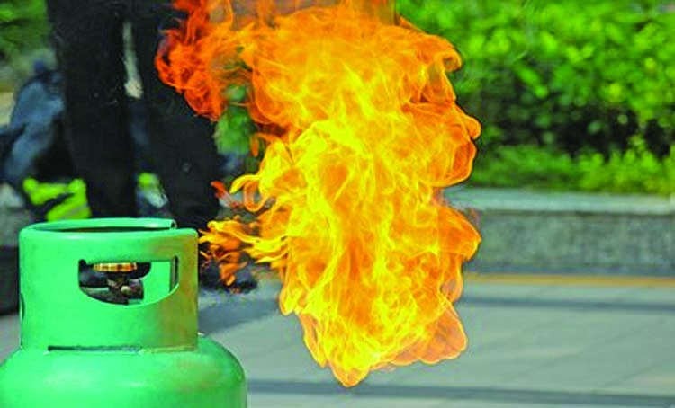
Gas leaks, especially from cooking gas (LPG) or natural gas, can lead to dangerous situations like fires, explosions, or carbon monoxide poisoning both in residential houses and industries

Slide 5

Situation in bangladesh
[2]
A report by Prothom Alo on March 5, 2021 revealed that more than 500 leakages are reported in Dhaka every month.^{[1]} While Gas explosions claim 82 lives in 3 years in Narayanganj from 2020 to 2022.^{[3]}

Slide 6
How to prevent such gas leaks explosions?

Slide 7

How to prevent such gas leaks explosions?
Recognize, Prevent, and Take Action
Among them Recognize or Detection is the first and most crucial!

Slide 8

BUT…
Manual detection may not be sufficient due to distraction, absence from home, or simple forgetfulness.

Slide 9
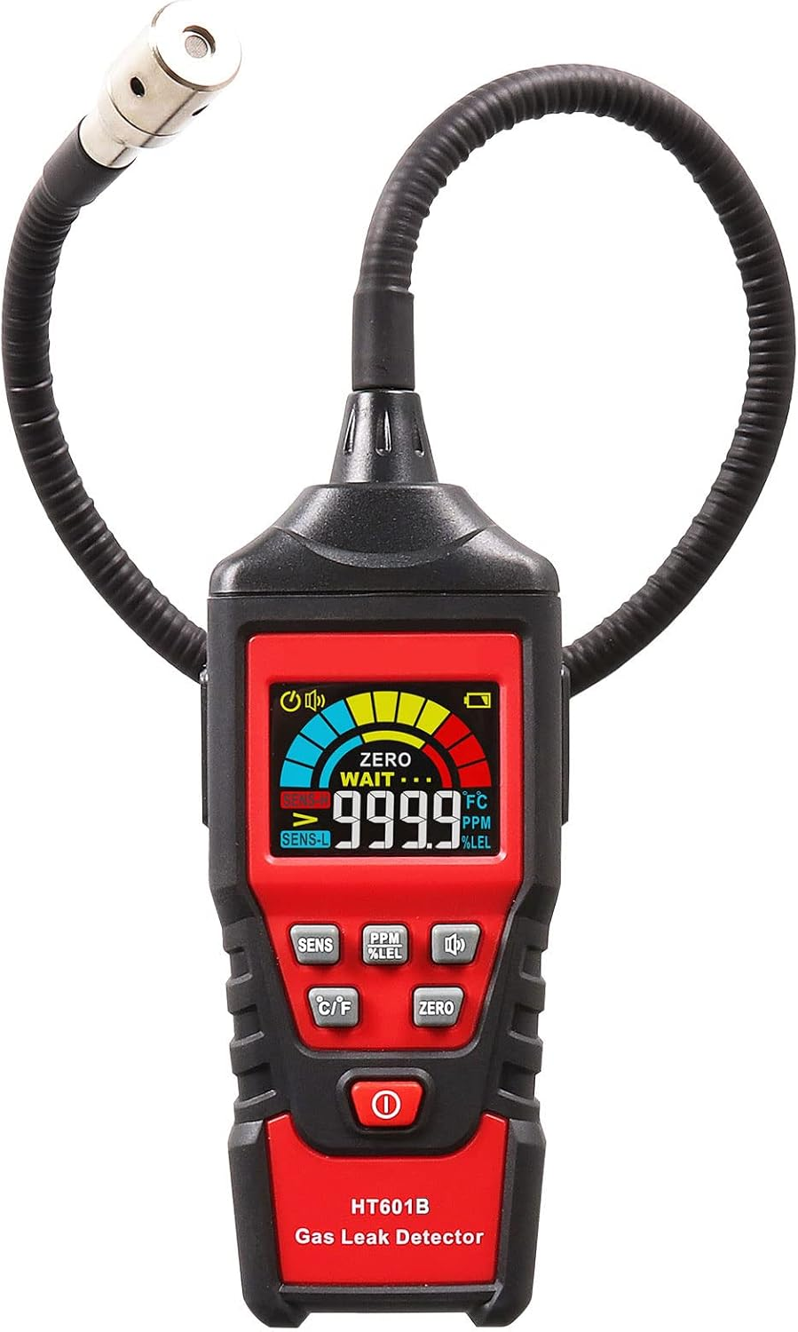
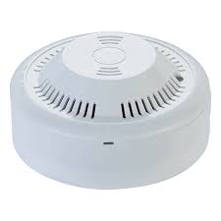
Technological solution
Technology lends us a big hand, helping us with automatic checks 24 hours a day, 365 days a year
Different GAS Detectors

Slide 10
System overview

Slide 11

How the Gas Detection System Works
The sensor monitors gas concentration and triggers an alert when a predefined threshold is crossed.

Slide 12
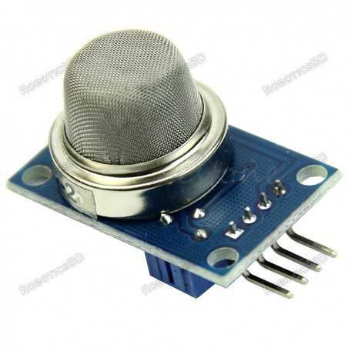
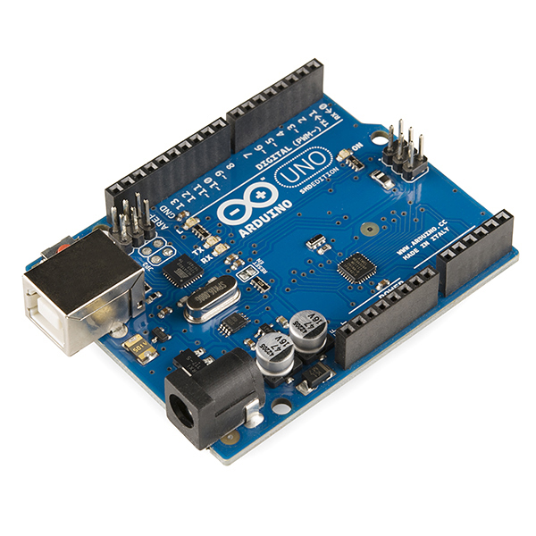

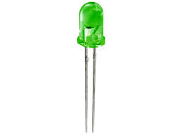
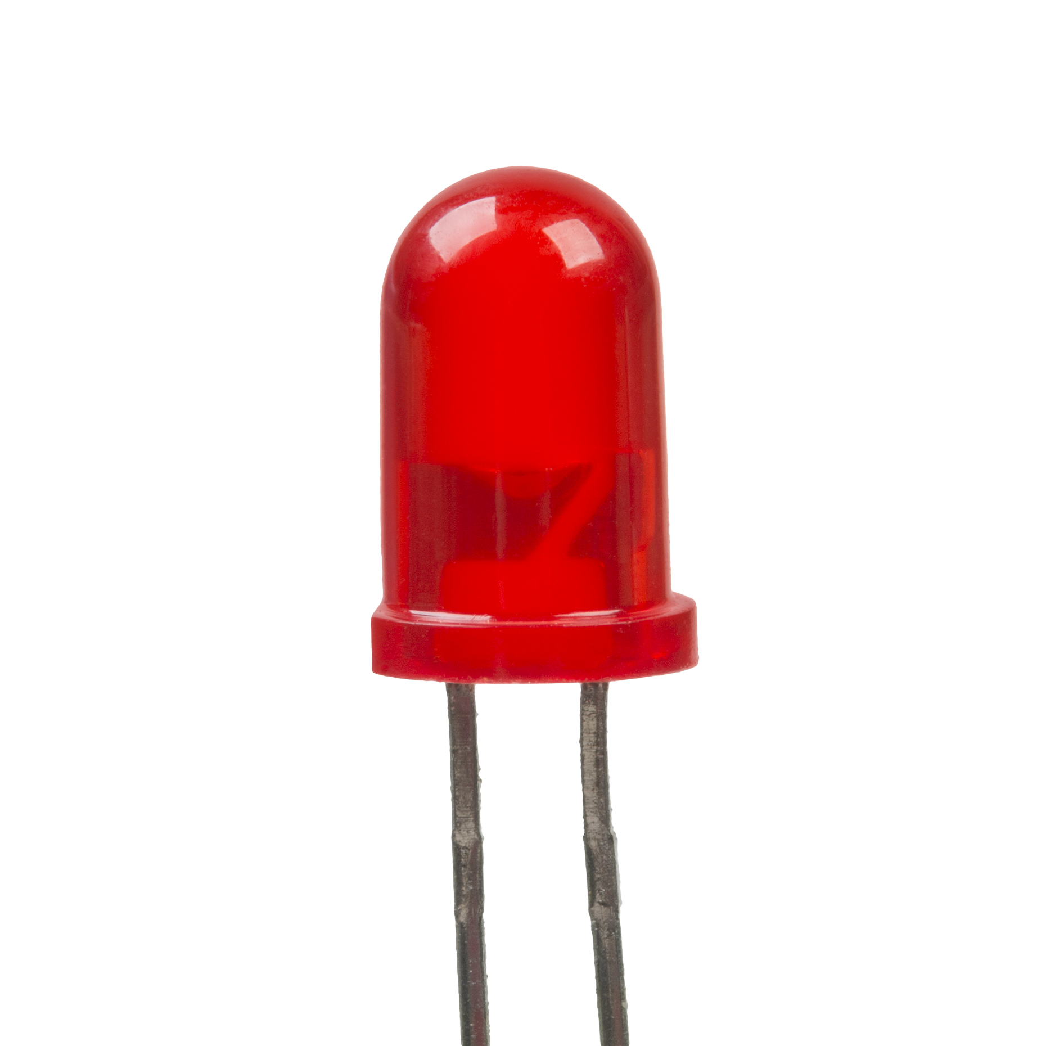

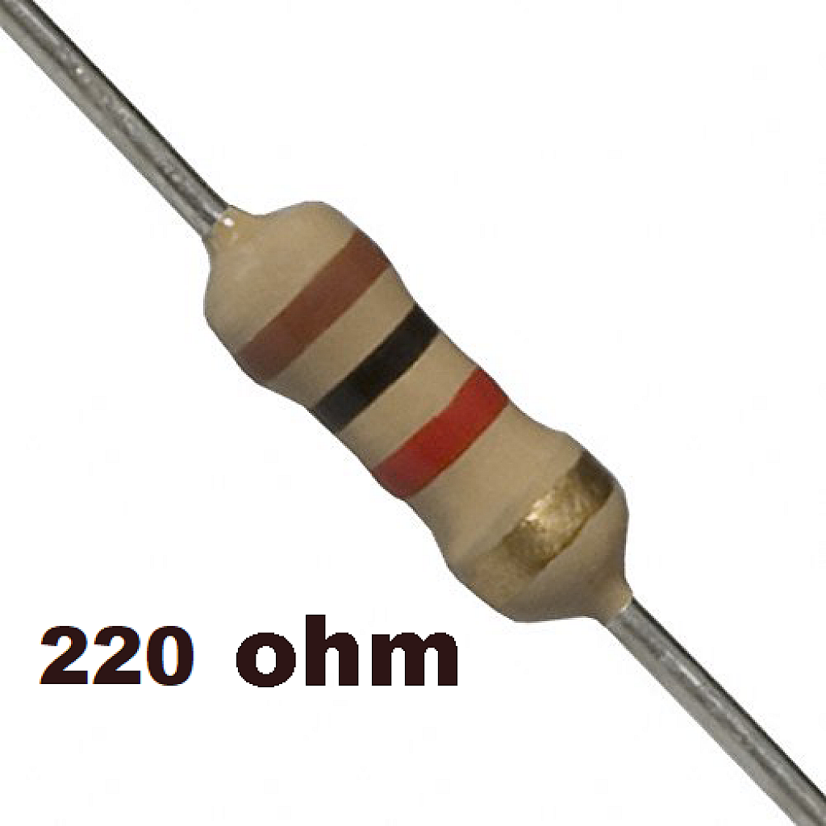
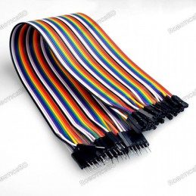
Main components
MQ-2 Gas Sensor Arduino UNO Piezo (Buzzer) LED
Bread Board
Resistor
Jumper Wires

Slide 13
Circuit diagram

Slide 14
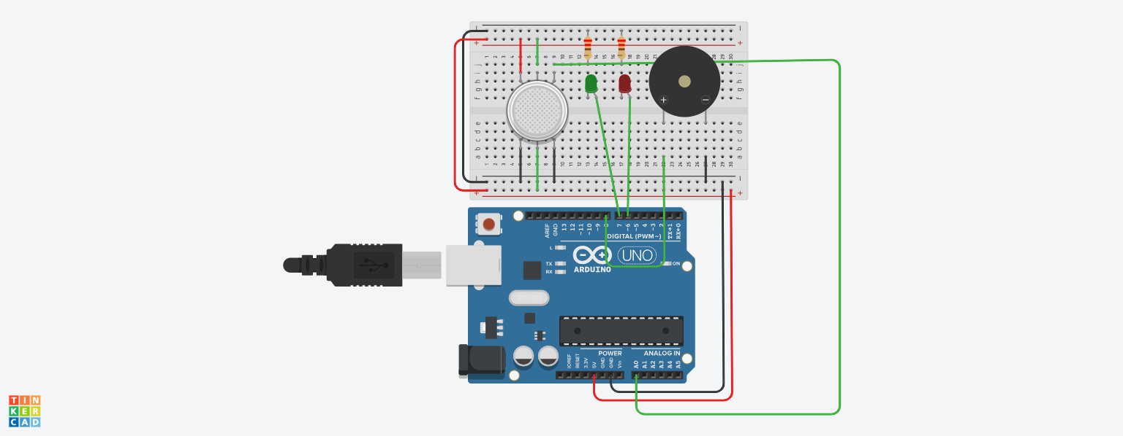
220 Ω Resistor
Piezo (Buzzer)
MQ-2 Sensor
Red LED
Green LED
Arduino UNO
Figure: Gas Leakage Detection System

Slide 15
Code Snippet

Slide 16


Slide 17
System Operation

Slide 18
Threshold value
This analog voltage of the sensor is read by the Arduino as a value between 0 and 1023 (corresponding to 0V to 5V). The threshold of 400 is a chosen reference point to indicate when gas levels become potentially dangerous.^{[4]}

Slide 19
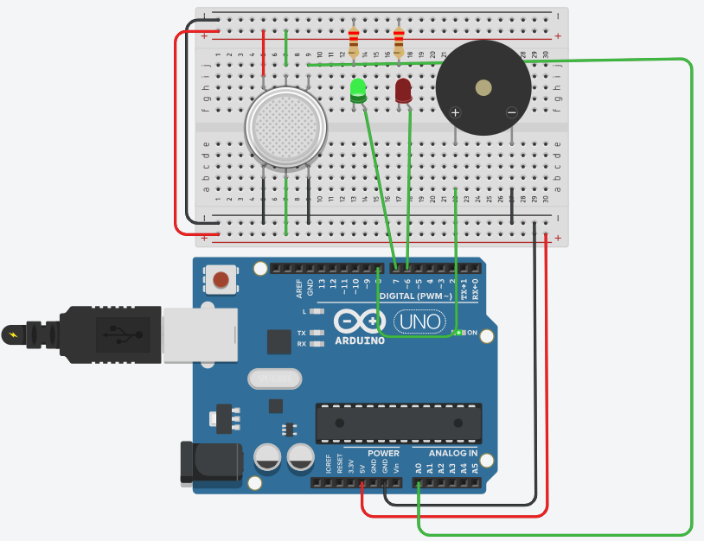
Safe Condition:
When the gas concentration detected by the MQ-2 sensor is below the set threshold (e.g., 400), the system operates in a safe mode.
In this state, the green LED remains lit, indicating that the environment is free from any hazardous gas leaks.
The buzzer stays off, meaning there is no immediate danger, and no action is required from the user.
Gas Level Under Threshold

Slide 20
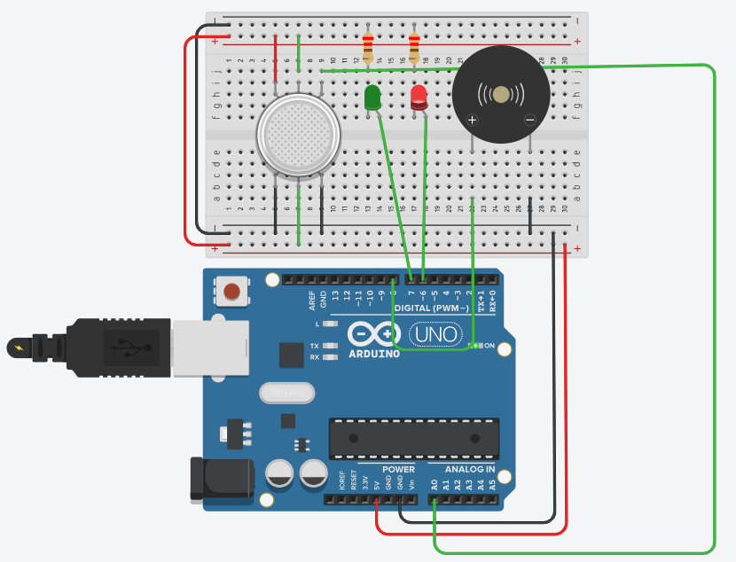
Gas Leak Detected:
When the gas concentration crosses the predefined threshold, the system immediately switches to an alert state.
In this scenario, the red LED turns on, signaling a potentially dangerous situation due to the presence of high gas levels.
Simultaneously, the buzzer is activated, emitting a loud sound to alert nearby individuals of the detected gas leak.
Gas Level Over Threshold

Slide 21
OUTPUT

Slide 22
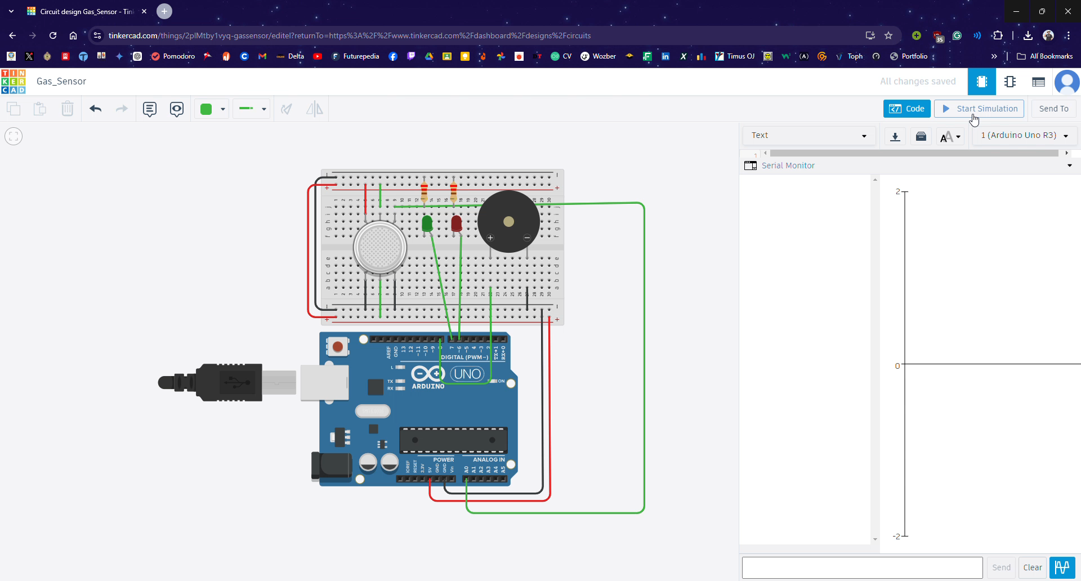

Slide 23

Conclusion

Slide 24
Project Summary:
Utilizing the MQ-2 gas sensor and Arduino, the project effectively combines visual (LED) and audible (buzzer) alarms to ensure a swift response in case of a gas leak, reducing the risk of accidents such as fires or explosions.
POTENTIAL USES :
Homes: In domestic environments, the system can be used to monitor kitchens or storage areas where LPG, natural gas, or other combustible gases are present.
Industries: In industrial settings where gases are commonly used or stored, such as chemical plants, refineries, or factories, this system can enhance safety measures.
Commercial Spaces: Restaurants, hotels, and other commercial spaces using gas appliances can benefit from this system to ensure customer and staff safety.

Slide 25


Future Improvements:
Add Wi-Fi for Remote Monitoring: By incorporating a Wi-Fi module (e.g., ESP8266) into the system, users can receive real-time alerts on their smartphones or other connected devices, even when they are away from the premises.
Integrate an Automatic Gas Supply Cutoff Using a Relay: A relay module can be added to automatically shut off the gas supply when a leak is detected.

Slide 26
REFERENCES
https://www.thedailystar.net/opinion/views/the-overton-window/news/the-verge-explosion-3304956
https://www.dhakatribune.com/ , https://bdnews24.com/ https://www.voanews.com/
https://www.dhakatribune.com/bangladesh/nation/305402/gas-explosions-claim-82-lives-in-3-years-in
S. J. D. Galceran, F. J. H. Villarico, J. J. C. Omao, L. C. P. Estaniel, I. J. P. Saldo, J. R. D. Calo, and M. J. P. Dandoy, "Development and Comparison of Arduino-Based MQ-2 and MQ-6 LPG Leak Sensors," American Journal of Sensor Technology, vol. 7, no. 1, pp. 1-9, 2023, doi: 10.12691/ajst-7-1-1.

Slide 27

Thank you

